Slide 1
Genomic Analysis Toolkit (GATK)
Does [0] compute?
Li Lei
Feb 7, 2017

Slide 2
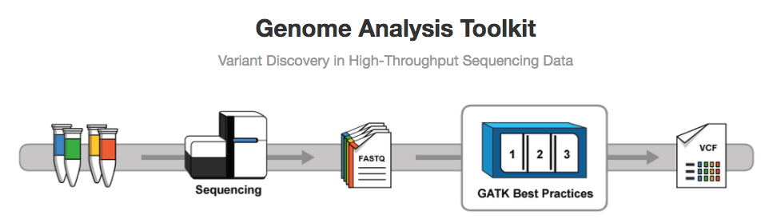
(GATK)
Download slides from: https://github.com/MorrellLAB/DoesNaughtCompute/blob/master/GATK_SNPs_calling/DoesNaughtCompute_gatk.pptx

Slide 3
What is variants call?
A variant call is a conclusion that there is a nucleotide difference vs. some reference at a given position in an individual genome or transcriptome
Usually accompanied by an estimate of variant frequency and some measure of confidence.

Slide 4
Why need to call variants?

Slide 5
Why need to call variants?
DNA-seq: variants
Genetic associations with certain traits
Mutations annotation, e.g., deleterious mutations
Characterizing the features of populations, e.g., F_{st}, Linkage disequilibrium
RNA-seq:
Allele-specific expression
Allelic imbalance, often differential
Association with isoform usage (splicing QTLs)
RNA editing (allele absent from genome)
ChIP-seq: allele-specific binding

Slide 6
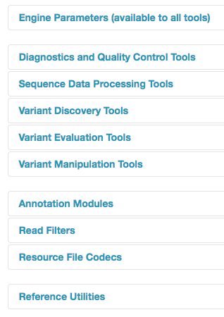
What can GATK do?
Notes:
1Downsampling coverage fraction interval intersection, 2 ASE counts 3 BaseRecalibrator indel realignment 4 haplotype caller , GenotypeGVCFs 5. Genotype concordance between two callsets

Slide 7
Best Practices workflow
sequence_handling

Slide 8
sequence_handling handlers
Quality Assessment - FastQC (Oct 06th – Paul Hoffman)
Read depths - Zip/Unzip/Grep
Adapter trimming - Scythe (Oct 13th – Chaochih Liu)
Quality trimming - Sickle/ Seqqs (Oct 13th - Chaochih Liu)
Read mapping - BWA-MEM (Oct 20th/ 27th – P. Morrell/ Y. Zhang)
SAM processing - Picard/ SAMtools (Nov 10th /17th - L. Lei/ C. Pierce)
Coverage mapping - BEDtools
Indel realignment - GATK

Slide 18
https://software.broadinstitute.org/gatk/documentation/topic?name=methods

Slide 21
HaplotypeCaller algorithm
Notes:
1Sliding window along the genome reference Count mismatches, indels and soft clips;2 Local re-assembly Traverse graph to collect most likely haplotypes, Align haplotypes to ref using Smith-Waterman
3 Calculate haplotype likelihoods given the read – PairHMM aligns each read to each haplotype4 Bayesian model to determine the genotypes

Slide 22
Work flow of variants calling

Slide 23
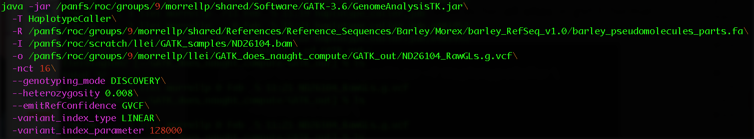
Example of SNP calling with HyplotypeCaller
Extension must be .vcf, or .g.vcf but NOT .gvcf

Slide 24
VCF vs. gVCF

Slide 27
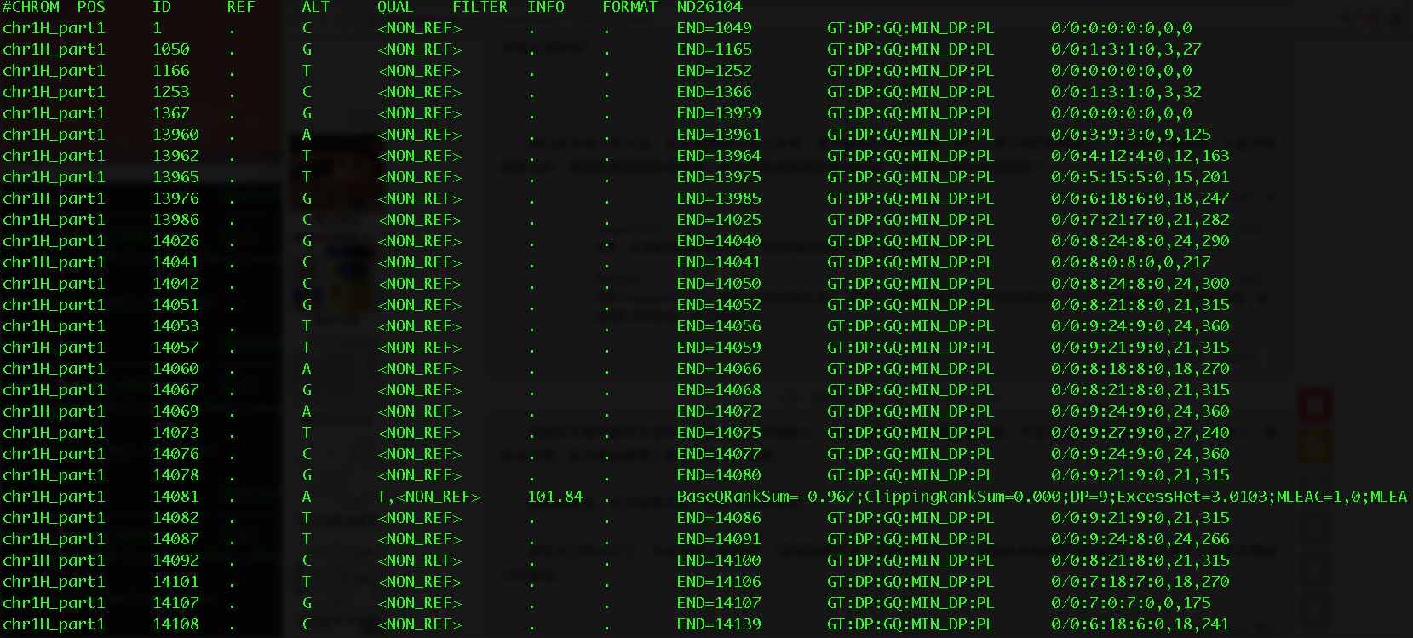

Slide 31
Coding challenge
#Call SNPs with GATK haplotypeCaller
#Login MSI
git clone /panfs/roc/groups/9/morrellp/public/GATK_Example_Data
git clone https://github.com/MorrellLAB/DoesNaughtCompute.git
cd GATK_SNPs_calling
vi GATK_GenotypeGVCFs.job
# Then revise the script according to the comments and save the file
ssh lab
qsub GATK_GenotypeGVCFs.job
#GenotypeGVCFs:
#Then revise the script according to the comments and save the file
qsub haplotype_caller.job

Slide 32
Reference
https://drive.google.com/drive/folders/0BwTg3aXzGxEDVE10Z01yWHVtYlU

